Slide 1
Phonics Workshop
Monica Sharma (Head of English)
Lydia Jenkins (Phonics Lead)

Slide 3
Reading At TMA
As a school, we are always driving reading.
Reading is a life skill
Everything that we do linked to raising the profile of reading comes under the banner of Read to Succeed
Constantly updating books in shared areas- last year spent £2000 on books
Initiatives from last year-
Postcards for library, National Poetry Day, potato characters, World Book Day, book recommendations for parents on Fb/parentpay, Years 3 and 5 author visitors, to just name a few, reading tuition provided for identified children

Slide 4
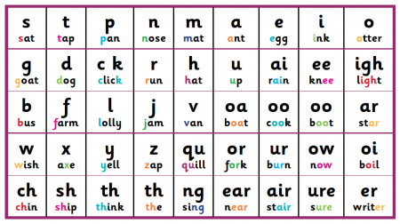
What are phonics?
Single sounds (phonemes) produced when reading a letter (grapheme) or letters.
How does this differ from learning the ABC's (names of letters)?

Slide 5
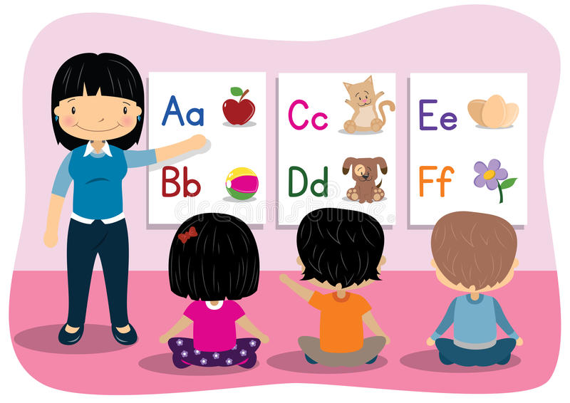
Why are they important?
Traditionally, children were taught letter names like ay, bee, sea, these don’t always represent their pronunciation
(W = double u).
The phonic approach encourages us to directly link letters to sounds.
W E T= Wet
CH A T = Chat

Slide 6
Read Write Inc Phonics (Ruth Miskin)
This is the phonics programme that we use at Two Mile Ash school
Fidelity to Ruth Miskin
Ashbrook and Holmwood
Why is my child on this programme?
What happens when my child completes the
programme?

Slide 7
How is it taught?
Speed Sound chart
Phonics cards
Story Books
Comprehension
Spellings
Writing

Slide 8
Terminology
Your child may begin to use terminology that you are unfamiliar with - this glossary of terms may help!
Green words
Green words are words that can be broken down into sounds, and blended together to read.
Red words
Red words are words that cannot be broken down. These are taught explicitly, and are words that children need to read by sight.

Slide 9
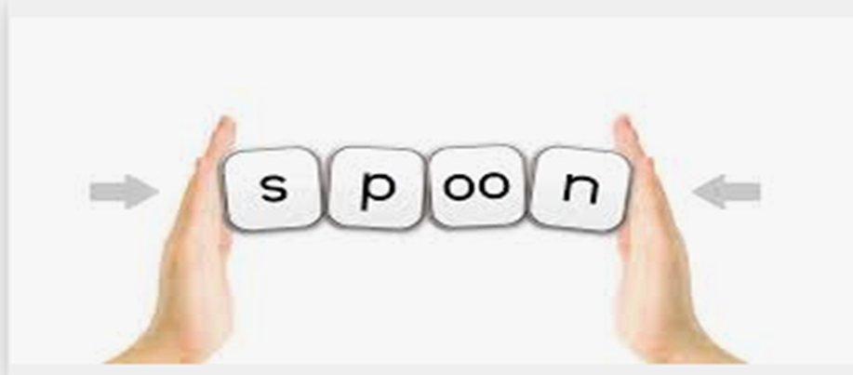
Fred Talk- used for reading
Your child will be encouraged to sound out words that they cannot read. We call this “Fred Talk”. Fred is a frog that joins the children in every session and he can only talk in sounds!
The children blend the sounds to form the whole word
c-a-t = cat
sh-o-p= shop
n-igh-t= night
https://www.youtube.com/watch?v=dEzfpod5w_Q

Slide 10
Spellings
Fred Fingers
Fred Fingers are used for spelling. Children hold up the hand that they do not write with. They sound out the word they are spelling and put up the correct number of fingers for the word.
For example: m-ee-t = 3 sounds = 3 fingers.
Ask your child how many sounds they can hear in the word “meet”
Ask your child to put up their Fred Fingers (there should be three)
Using the hand that your child writes with, they pinch the first finger and say the first sound in the word ‘m’
Pinch the middle finger and say ‘ee’
Pinch the last finger and say ‘t’
Fingers are pinched left to right, as we would read.

Slide 11
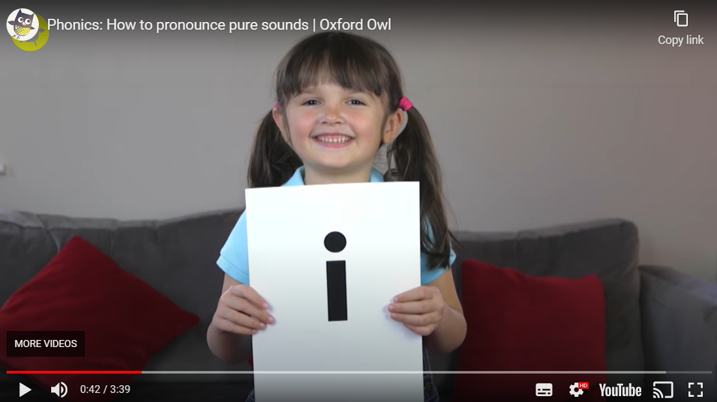
How to:
https://youtu.be/UCI2mu7URBc

Slide 12
Children who have two books
We continually assess to see where our children are with their reading fluency. We find that children who find reading challenging may have gaps in their phonics, which we address in English lessons and additional interventions.
Your child may come home with two reading books. One of these books is for them to build up their phonics knowledge and sight words and the other is for them to read with an adult, with the adult taking the lead. This will mean that the pupil will be practising their phonics as well as being exposed to books that they are interested in and will increase their vocabulary, hence encouraging their love of reading. If your child is receiving two books, the school will notify you of this.
Your child may also be given additional Bug Club homework or Rapid Read homework to encourage their reading fluency or comprehension. If this is the case, again the school will notify you.

Slide 13
Have a look at the resources on your table
Feel free to ask us any questions

Slide 14
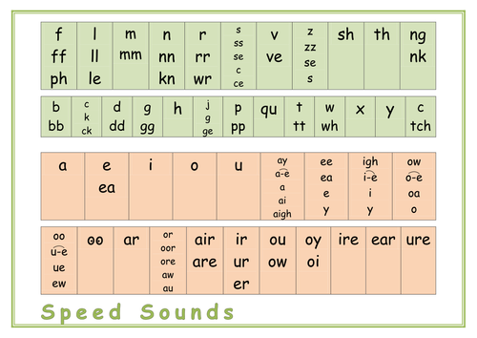
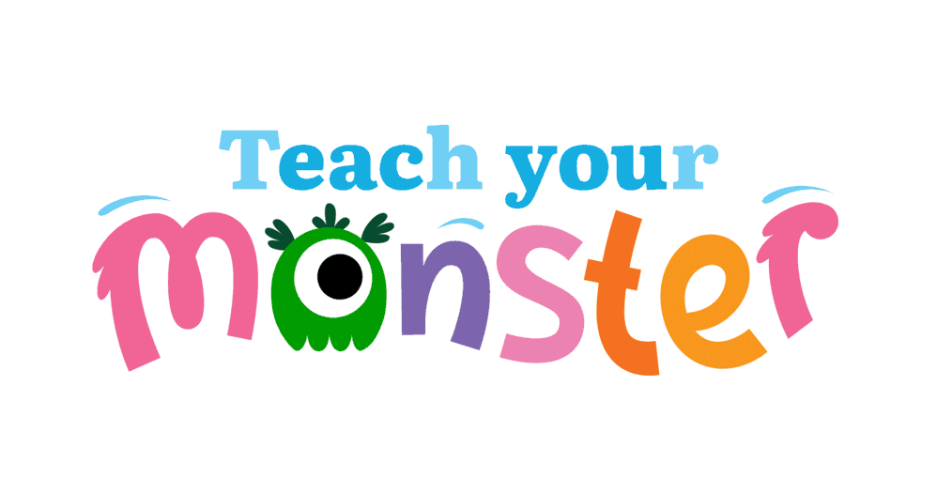
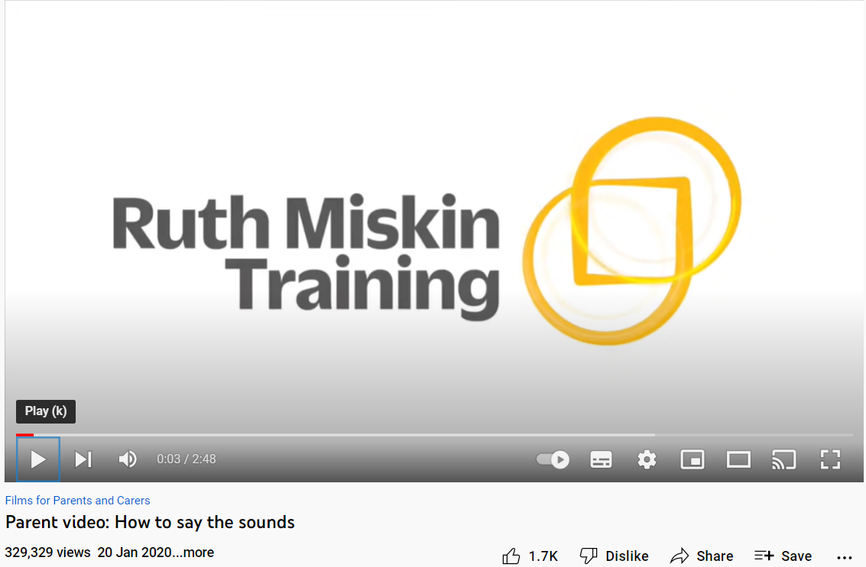
Resources
1. Oxford Owl
https://home.oxfordowl.co.uk/reading/what-is-letters-and-sounds/
(Shows order of acquisition)
2. Phonic Chart/ flash cards
3. YouTube:
https://youtu.be/TkXcabDUg7Q
4. Parents - Ruth Miskin Literacy
5. Teach Your Monster to Read:
https://www.teachyourmonster.org/account

